Slide 1

HealthTechNet
2017 Health Policy Outlook
February 17, 2017
Nathan Bays, Esq.
General Counsel, The Health Management Academy
Executive Director, The Academy Advisors

Slide 2
Overview
The Affordable Care Act: Past, Present, and Future
  What’s at stake—recap of the ACA and its implications for Leading Health Systems
  Reconciliation and Republican Proposals
Politics of Health Care
  The 2018 election cycle and its implications on health care legislation
MACRA
  Final rule overview and strategic considerations

Slide 3
The Affordable Care Act: Past, Present, and Future
Notes:
http://healthaffairs.org/blog/2014/07/02/the-payment-reform-landscape-bundled-payment/

Slide 4
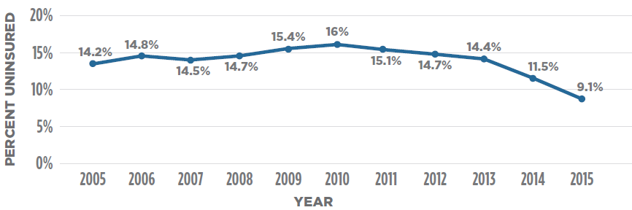
What’s At Stake: Coverage Provisions
Individual Mandate: Penalties for individuals without insurance
Employer Mandate: Penalties for medium and large employers for not offering affordable coverage
Guaranteed Issue: No denial of coverage, or variable premiums based on health status/ gender
Dependent Coverage Provision: Coverage on parents’ plans until age 26
Minimum Standards: Every policy must include Essential Health Benefits
Notes:
Source: CDC 2015 National Health Interview Survey
https://www.cdc.gov/nchs/data/nhis/earlyrelease/earlyrelease201605.pdf

Slide 5
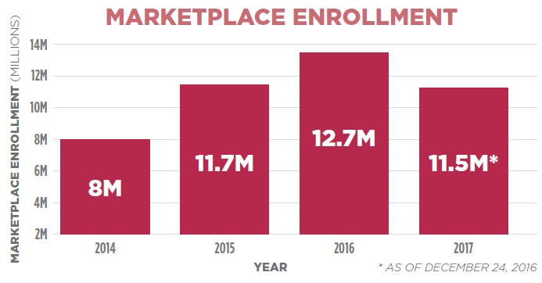
What’s At Stake: ACA Exchanges & Subsidies
Available for small businesses/ individuals without public or affordable employer coverage
Advance premium tax credits provided to families without other coverage and with incomes 100-400% of the poverty level
Cost-sharing reductions available to those with incomes between 100-250% of poverty level
More than 80% of enrollees in Marketplace receive advance premium tax credits
Notes:
https://downloads.cms.gov/files/final-marketplace-mid-year-2017-enrollment-report-1-10-2017.pdf

Slide 6
What’s At Stake: Medicaid Expansion
For parents: ACA expanded eligibility from 91% to 133% (effectively 138%) of FPL
For other adults: ACA introduced eligibility to those without dependents under 133% (effectively 138%) of FPL
Expansion states provided 100% federal funding for newly eligible from 2014-2016, 95% in 2017, and 90% by 2020
32 states expanded (including DC)
About 14 million new lives covered
Notes:
https://www.medicaid.gov/medicaid/program-information/medicaid-and-chip-enrollment-data/monthly-reports/index.html

Slide 7
What’s At Stake: Quality & Innovation Provisions
Hospital Value-based Purchasing Program
HAC Payment Adjustments
Quality Reporting for Inpatient Psychiatric Hospitals
Hospital Readmissions Reduction Program
Medicare Shared Savings Program
Value-based Purchasing Programs for SNFs, HHAs, and ASCs
Quality Reporting for LTCHs, IRFs, and hospices
Quality Reporting for PPS-Exempt Cancer Hospitals
Center for Medicare and Medicaid Innovation

Slide 8
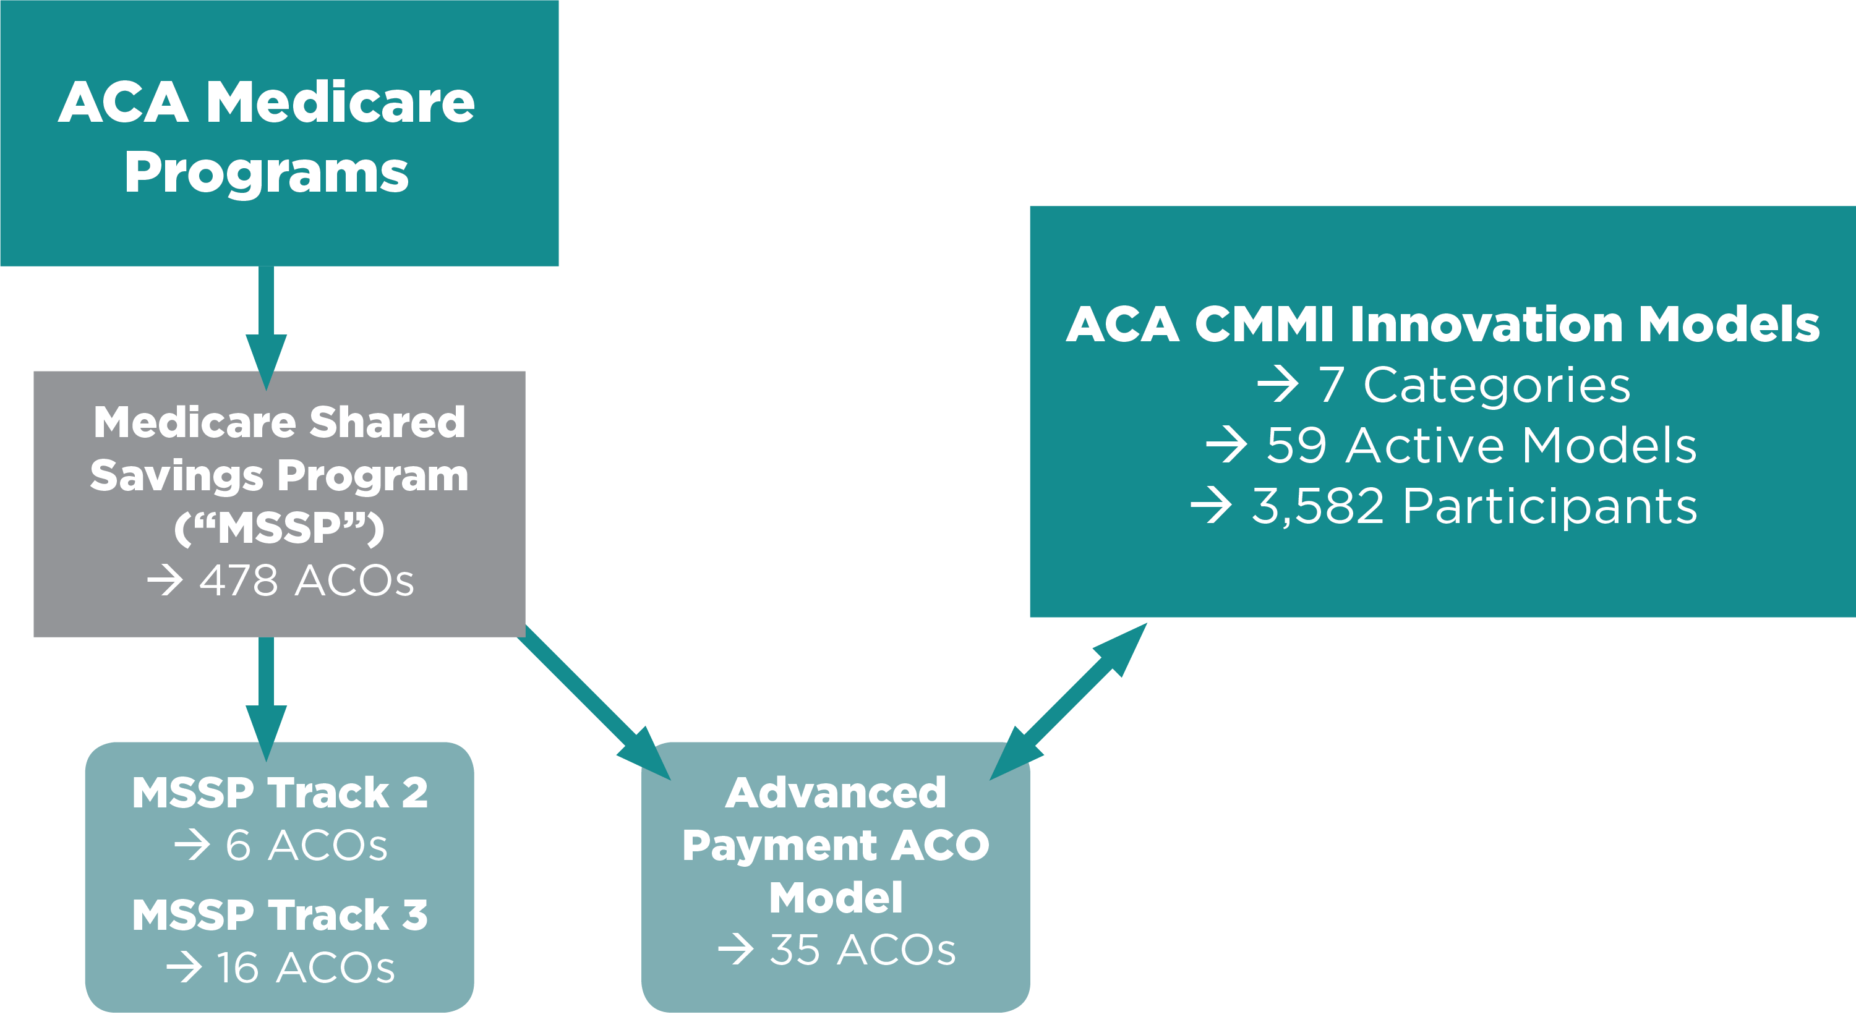
Value Based Payment Models
8

Slide 9
ACA: What Leading Health Systems Gave Up
$155 billion in direct hospital cuts
Disproportionate share hospital cuts (Medicare and Medicaid)
Productivity adjustments
Hospital-acquired conditions program
Hospital readmissions reduction program
Medicare Advantage—$135.6 billion—indirect, but still relevant to Leading Health Systems
Source: Congressional Budget Office, March 20, 2010
Notes:
Source: CDC 2015 National Health Interview Survey
https://www.cdc.gov/nchs/data/nhis/earlyrelease/earlyrelease201605.pdf

Slide 10
ACA Repeal and Replace: A Plan Emerges
On February 16 Republicans released the first iteration of their ‘repeal and replace’ plan
The plan includes the following components
  Medicaid expansion repeal
  Medicaid per-capita caps—with a block grant option
  Restoration of Medicaid DSH Cuts
  Universal Tax Credits
  State Innovation Grants
  Enhanced Health Savings Accounts
Republicans plan to move forward with this plan over the coming weeks, although there is much dissension within the party

Slide 11
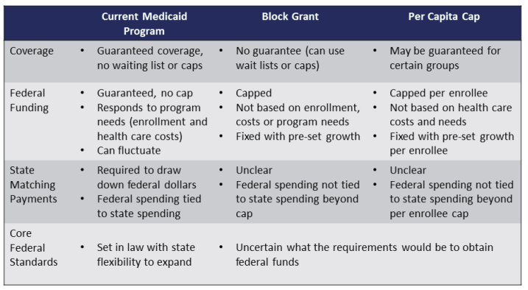
Medicaid Today, Medicaid Tomorrow?
Source: Kaiser Family Foundation

Slide 12


“It ain’t what you don’t know that gets you into trouble. It’s what you know for certain that just ain’t true.” Mark Twain
I never think of the future. It comes soon enough. Albert Einstein

Slide 13
The Politics of Health Care
Notes:
http://healthaffairs.org/blog/2014/07/02/the-payment-reform-landscape-bundled-payment/

Slide 14




Donald Trump starts his Presidency in a far weaker position than his three predecessors
President-Elect Image Ratings In January of Inaugural Year
President-Elect | Positive | Negative | Net Difference
Bill Clinton ‘93 | 64% | 16% | +48%
George W. Bush ’01 | 50% | 30% | +20%
Barack Obama ’09 | 67% | 13% | +54%
Donald Trump ‘17 | 38% | 48% | -10%
Source: Public Opinion Strategies/NBC WSJ National Survey Data

Slide 15
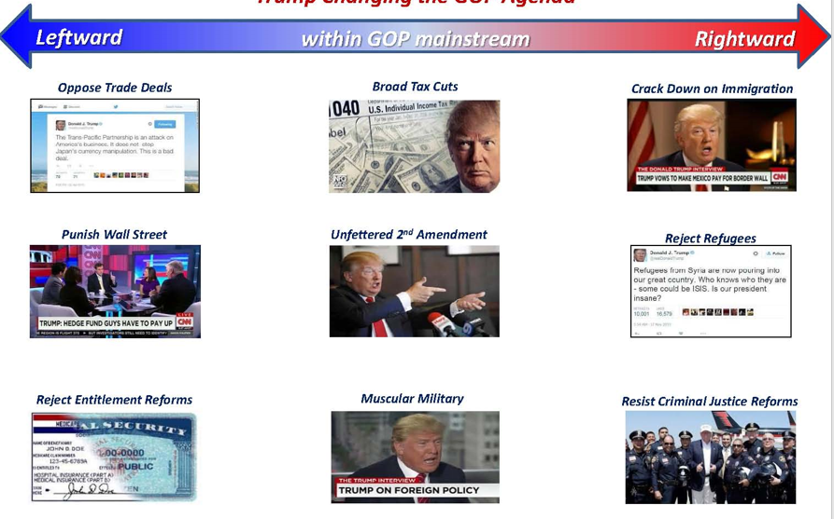
Trump is changing the GOP agenda
Source: Mehlman Castagnetti Rosen & Thomas

Slide 16
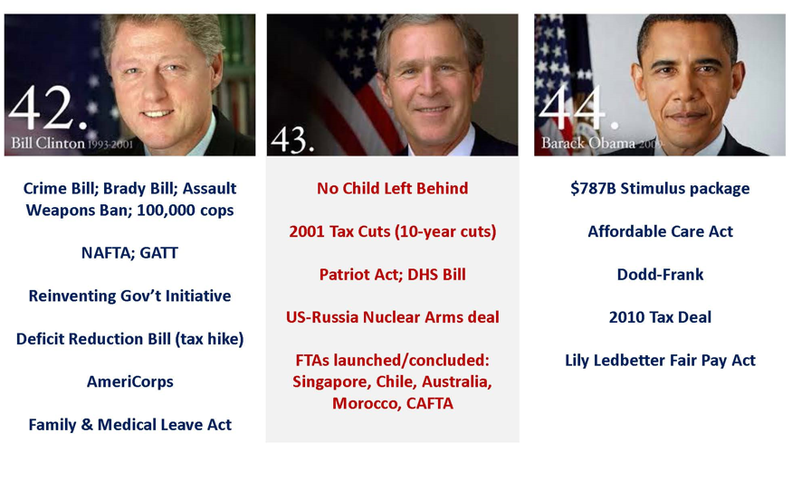
His first two years will be critical
to his Presidency
Source: Mehlman Castagnetti Rosen & Thomas

Slide 17
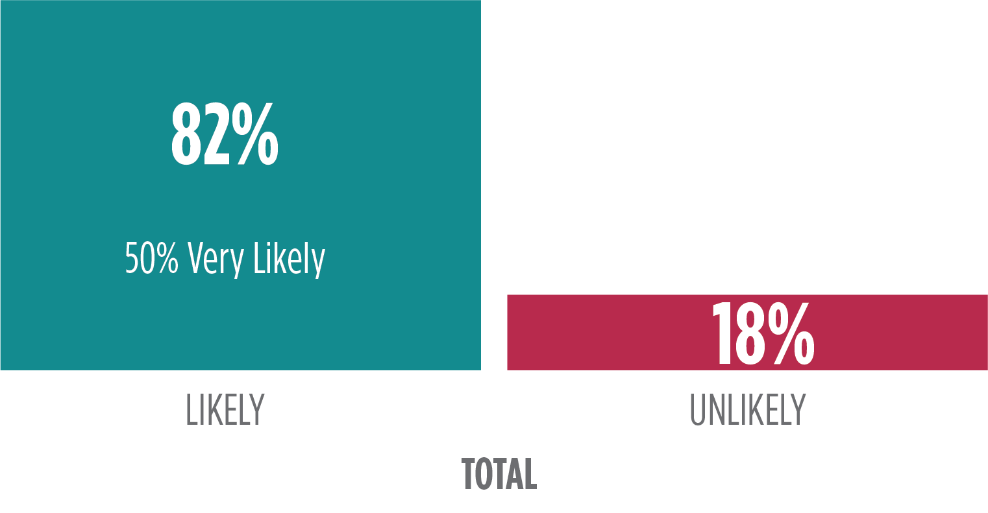
More than 8 in 10 Americans believe President Trump will repeal and replace the ACA
How likely is it that Donald Trump will accomplish each of the following – very likely,
somewhat likely, not very likely, or not likely at all?
Repeal and replace the health care law known as Obamacare
50% Very Likely
Likely
Unlikely
Data from a CNN national survey of 1,000 adults, conducted January 12-15, 2017

Slide 18
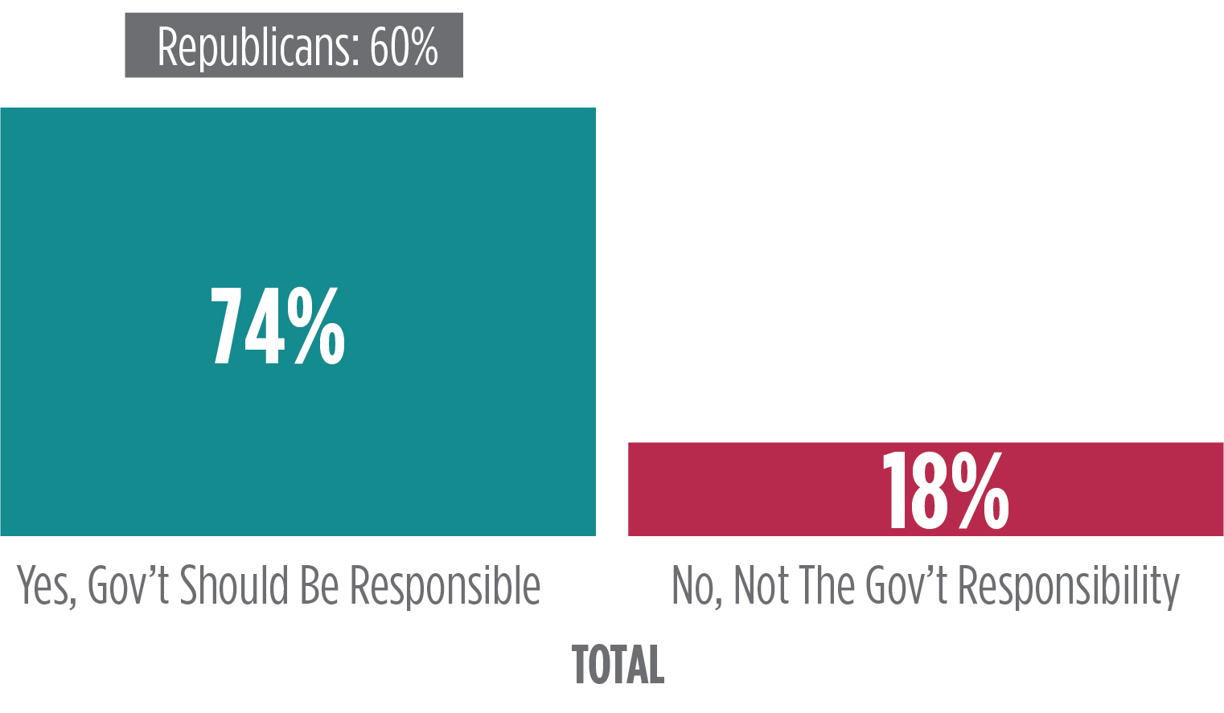
But, Americans expect the administration to provide coverage to those who lose it
If the Affordable Care Act [also known as Obamacare] is repealed, roughly 20 million Americans would be at risk for losing health insurance.
Do you believe the government should find a way to make sure these Americans do not lose their health insurance coverage?
Yes, Gov’t Should Be Responsible
No, Not The Govt’s Responsibility
Data from a HMA national survey of 2,004 adults, conducted November 20-22, 2017

Slide 19
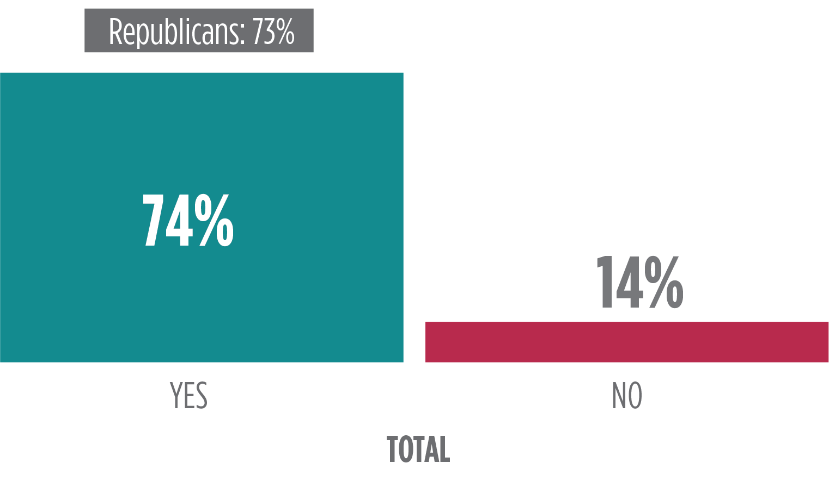
Expect something to happen from the administration and Congress on drug pricing
During her campaign for President, Hillary Clinton frequently talked about challenging prescription drug companies for continuing to raise prices on prescription drugs.
Once he officially takes office, do you believe Donald Trump should challenge prescription drug companies?
Data from a HMA national survey of 2,004 adults, conducted November 20-22, 2017

Slide 20
MACRA
Notes:
http://healthaffairs.org/blog/2014/07/02/the-payment-reform-landscape-bundled-payment/

Slide 21
MACRA Background: A Refresher
Process
  Legislation passed in April, 2015—repealed the SGR
  Proposed rule released in April 2016, Final Rule October 2016
  First “Performance Year” begins on January 1 2016
Politics
  Sponsored by Rep. Michael Burgess (R-TX), a physician
  Strong bi-partisan support
    Passed the House 392-7, Passed the Senate 92-8
  MACRA will stay—will not be repealed
Structure
  Creates a regime for those who practice primarily in fee-for-service models—the Merit-based Incentive Payment System (“MIPS”)—and one for those who practice through down-side risk-bearing payment models.

Slide 22
MACRA QPP Participation Categories
SUBJECT TO MIPS
MIPS Eligible Clinician
MIPS APM Participant
Partial Qualifying APM Clinician
Advanced APM Qualifying Clinician
Eligible clinicians not meeting APM thresholds, or low-volume or new to Medicare exclusions
MIPS eligible clinicians participating in Advanced APM models—plus MSSP Track 1 & one-sided OCM—but below partial qualifying thresholds
Eligible clinicians not meeting Advanced APM thresholds, but coming close
Eligible clinicians meeting full participation thresholds in Advanced APMs
Source: The Health Management Academy

Slide 23
Merit-based Incentive Payment System (“MIPS”) Structure
Measure Performance
Two year look-back – performance measurements begin in 2017 for 2019 payment adjustments
Composite Score
Based on scores in each performance category, participants receive an annual composite score between 0-100
Threshold Comparison
Each clinician’s score will be compared against a performance threshold to determine payment adjustments
Beginning in 2019, performance threshold will be the median of all MIPS scores – competition among peers
Score will be publicly available via Physician Compare
Additional Adjustments
Adjustments are budget neutral – upward adjustment can be scaled up or down, with the scaling factor not to exceed 3 times the baseline adjustment
EHR MU, PQRS, and VBM – sunset in 2018, with certain measures incorporated into new MIPS categories
Additional exceptional performance adjustment offered to small number of best performers
4 weighted MIPS categories – Quality, Cost, Advancing Care Information, Improvement Activities
Choice of reporting as an individual clinician or as a group
If practices choose to report as a group (defined at the TIN-level), all clinicians will receive the same score

Slide 24
MACRA Physician Payment Adjustments
2015 | 2016 | 2017 | 2018 | 2019 | 2020 | 2021 | 2022 | 2023 | 2024 | 2025 | 2026+
Annual Updates
Jan-Jun 0% Jul-Dec 0.5% | 0.5% | 0.5% | 0.5% | 0.5% | 0% | 0% | 0% | 0% | 0% | 0% | MIPS: .25% Qualified APMs: .75%
PQRS, MU, VBM Max Penalties
-3.5% | -6% | -9% | TBD | PQRS, MU, VBM Measures Incorporated into MIPS
 |  |  |  | MIPS Baseline Payment Adjustment
 |  |  |  | (+/-) 4% | (+/-) 5% | (+/-) 7% | (+/-) 9% | (+/-) 9% | (+/-) 9% | (+/-) 9% | (+/-) 9%
 |  |  |  | MIPS Maximum Possible Payment Adjustment
 |  |  |  | 12% | 15% | 21% | 27% | 27% | 27% | 27% | 27%
 |  |  |  | MIPS Exceptional Performance Adjustment
 |  |  |  | $500 Million Provided Annually by HHS Not to Exceed 10%
 |  |  |  | APM Bonus Payment APM Participants Excluded from MIPS
 |  |  |  | 5% | 5% | 5% | 5% | 5% | 5%

Slide 25
MIPS Eligibility Likely to Expand Over Time
In first 2 years, eligible providers include:
Physicians (MD, DO, DDS, DMD, DPM, OD, DC), PAs, NPs, clinical nurse specialists, certified registered nurse anesthetists, and groups that include such professionals
After year 2, HHS can determine other eligible professionals to subject to MIPS
Physical/occupational therapists, speech-language pathologists, audiologists, nurse midwives, clinical social workers, clinical psychologists, dieticians/nutritional professionals
3 Exclusions to MIPS participation
  Falls below “low-volume threshold”
  First year of Medicare Part B participation
  Qualification for Advanced APM Track (or Partial Qualifying)

Slide 26
Fewer MIPS Reporting Requirements & More Generous Scoring in 2017
Cost: Eliminated
Quality: Simplified, with More Protections
(fewer requirements; scoring floors on reported measures)
Advancing Care Information: More Flexible
(fewer measures; more opportunity for bonus points)
Improvement Activities: Less Burdensome
(fewer activities needed to achieve maximum score; automatic full credit for all current MIPS APMs)

Slide 27
Reporting Requirements In 2017—Clinicians Can “Pick Your Pace”
Small Positive Adjustment
Maximum Negative
Adjustment
Neutral
Adjustment
Larger Positive Adjustment
Advanced
APMs
-4%
Report
Minimum Amount in MIPS
Report any Quality measure that is low performing/ below case minimum/ not meeting data completeness thresholds/ without a benchmark…
Submit ANYTHING
Report
Partially in MIPS
Partial reporting
in performance categories, for at least a 90-day period
Report
Fully in MIPS
Complete reporting in all 3 categories, for at least a
90-day period
Participate Significantly
in Advanced APMs
Excluded from MIPS &
5% Bonus Payment
Report
Nothing in MIPS

Slide 28
MIPS Reporting Options
INDIVIDUAL
GROUP
APM ENTITY
Reports at individual level for each of the
4 performance categories
Receive individual score/payment adjustment at TIN/NPI level
A group, defined by TIN, would be assessed as group across all 4 performance categories
Receive score/payment adjustment at TIN/NPI level
All MIPS clinicians in group receive the same annual score
CMS will ultimately allow reporting through virtual groups, though not in 1st performance year
Option available to MIPS clinicians practicing in an APM deemed a “MIPS APM”
All scores aggregated at APM Entity level
All individuals in APM Entity receive the same annual score

Slide 29
Generally Applicable MIPS Category Weighting
2017 Performance Year
2019 Payment Year
2018 Performance Year
2020 Payment Year
2019 Performance Year
2021 Payment Year
%
%
%
Quality
Advancing Care Information
Improvement Activities
Quality
Cost
Advancing Care Information
Improvement Activities
Quality
Cost
Advancing Care Information
Improvement Activities

Slide 30
Weighting of Performance Categories for MIPS APMs
MSSP & Next Gen ACOs
Other MIPS APMs
%
%
Quality
Advancing Care Information
Improvement Activities
Advancing Care Information
Improvement Activities

Slide 31
Range of Payment Adjustments Fairly Small in 2017
Final Score Points | MIPS Adjustment
0 - 0.75 | -4%
0.76 - 2.9 | Negative MIPS payment adjustment greater than -4% and less than 0% on a linear sliding scale
3 | 0%
3.1 - 69.9 | Positive MIPS payment adjustment ranging from greater than 0% to 4% x scaling factor to preserve budget neutrality, on a linear sliding scale
70.0 - 100 | Positive MIPS payment adjustment AND additional MIPS payment adjustment for exceptional performance
($199 million)
$199 million
$500 million
Notes:
50k, 570k

Slide 32
New Advanced APMs Introduced Over Several Years
2017 Performance Year
Comprehensive ESRD Care Model
(LDO)
Comprehensive ESRD Care Model
(non-LDO)
CPC+
MSSP ACO Track 2
MSSP ACO Track 3
Next Generation ACO
Oncology Care Model (two-sided risk)
2018 Performance Year
MSSP Track 1+
New voluntary bundled payment model
CJR (CEHRT Track)
Cardiac bundles (CEHRT track)
CMS will reopen applications for CPC+ and Next Generation ACOs for the 2018 Performance Year

Slide 33
Advanced APM Participation: Benefits
  Three primary benefits for clinicians who practice in significant amounts through Advanced Alternative Payment Models:
  Clinician will be excluded from MIPS
  For payment years 2019-2024, clinician will receive a lump sum payment equal to 5% of Medicare Part B covered professional services from the prior year
  For payment years 2026 and beyond, the clinician will receive an annual adjustment under the PFS that is 50 basis points greater than MIPS clinicians
Notes:
http://healthaffairs.org/blog/2014/07/02/the-payment-reform-landscape-bundled-payment/

Slide 34
Advanced APM Qualification Thresholds
  Qualification Thresholds
    Physicians can qualify by meeting payment thresholds or by having
    a proportion of patients treated
    in an eligible APM
    CMS will make Threshold Score calculations under both payment
    & patient count methods and will use the most advantageous score
    QP determination will occur at the entity level, with the determination applying to all individual clinicians who are identified as part of the Advanced APM Entity
2017 | 2018 | 2019 | 2020 | 2021 | 2022+
% Medicare Payments Through Eligible APMs
25% |  | 50% |  | 75%
% Medicare Patients Through Eligible APMs
20% |  | 35% |  | 50%
% All-Payer Payments Through Eligible APMs
 |  | 50% Minimum 25% Medicare |  | 75% Minimum 25% Medicare
% All-Payer Patients Through Eligible APMs
 |  | 35% Minimum 20% Medicare |  | 50% Minimum 20% Medicare

Slide 35

Advanced Alternative
Payment Model (“APM”) List:
MACRA Decision Tree for Clinicians
The following models meet the criteria to be Advanced APMs in the 2017 performance year:
Medicare Shared Savings Program Track 2 Accountable Care Organization (“ACO”)
Medicare Shared Savings Program Track 3 ACO
Next Generation ACO
Comprehensive End-Stage Renal Disease Care Model
Oncology Care Model (two-sided risk agreement)
Comprehensive Primary Care Plus
?
Am I in an APM?
Subject to MIPS:
YES
NO
Am I in an
Advanced APM?
Am I excluded?
MIPS Exclusions:
NO
YES
Aside from participating in an Advanced APM, clinicians will only be excluded from MIPS if:
They fall below the low-volume threshold of $30,000 in Medicare Part B allowed charges or 100 Medicare Part B beneficiaries
They are in their first year of participating in Medicare Part B
YES
NO
Am I in a MIPS APM?
Qualifying Advanced
APM Participant (“QP”) Steps:
No MIPS payment adjustment
Am I a “QP”?
YES
NO
Do I want
to report?
Clinicians must meet the following criteria in order to be deemed a QP:
They must practice within an Advanced APM
They must be on the Participation List of the Advanced APM Entity by August 31 of the performance year
All clinicians, in aggregate, in the Advanced APM Entity must meet certain practice thresholds (in 2017, at least 25% of Medicare payments or 20% of Medicare patients through the Advanced APM)
YES
NO
++
Better MIPS score & larger positive payment adjustment likely
YES
NO
-
Negative payment adjustment
5% incentive payment
& excluded from MIPS
Am I a partial “QP”?
YES
NO
Do I want to report as an individual or group?
MIPS APM List:
Do I want to be in MIPS?
INDIVIDUAL
GROUP
The following models meet the criteria to be “MIPS APMs” in the 2017 performance year, offering MIPS reporting and scoring benefits to participating clinicians:
Medicare Shared Savings Program Track 1 ACO
Medicare Shared Savings Program Track 2 ACO
Medicare Shared Savings Program Track 3 ACO
Next Generation ACO
Comprehensive End-Stage Renal Disease Care Model
Oncology Care Model (one or two-sided agreements)
Comprehensive Primary Care Plus
NO
YES
Do I want to report complete or partial data?
Do we want to report complete or partial data?
No MIPS payment adjustment
COMPLETE
PARTIAL
COMPLETE
PARTIAL
++
Larger positive payment adjustment
+
Small positive payment adjustment
++
Larger positive payment adjustment
+
Small positive payment adjustment

Slide 36
Disclosure
Our financial relationships are with the Health Management Academy as our employer.
The information and opinions in this report were prepared by The Health Management Academy or one of its affiliates (collectively "Health Management Academy"). The information herein is believed to be reliable and has been obtained from public sources believed to be reliable. Health Management Academy makes no representation as to the accuracy or completeness of such information. Health Management Academy may engage in activities, on a proprietary basis or otherwise, in a manner inconsistent with the view taken in this research presentation. In addition, others within Health Management Academy, including strategists and staff, may take a view that is inconsistent with that taken in this research presentation. Opinions, estimates and projections in this report constitute the current judgment of the author as of the date of this report. They do not necessarily reflect the opinions of Health Management Academy and are subject to change without notice. Health Management Academy has no obligation to update, modify or amend this report or to otherwise notify a recipient thereof in the event that any opinion, forecast or estimate set forth herein, changes or subsequently becomes inaccurate.
This report is provided for informational purposes only.
Nathan Bays
+1 703.647.1028
Health Management Academy/The Academy Advisors
January 2017
Any reproduction by any person for any purpose without Health Management Academy’s written consent is prohibited.
Copyright © 2016 The Health Management Academy

